Slide 1
Panda’s Greeting
Lesson 2

Slide 2


Review

Slide 3
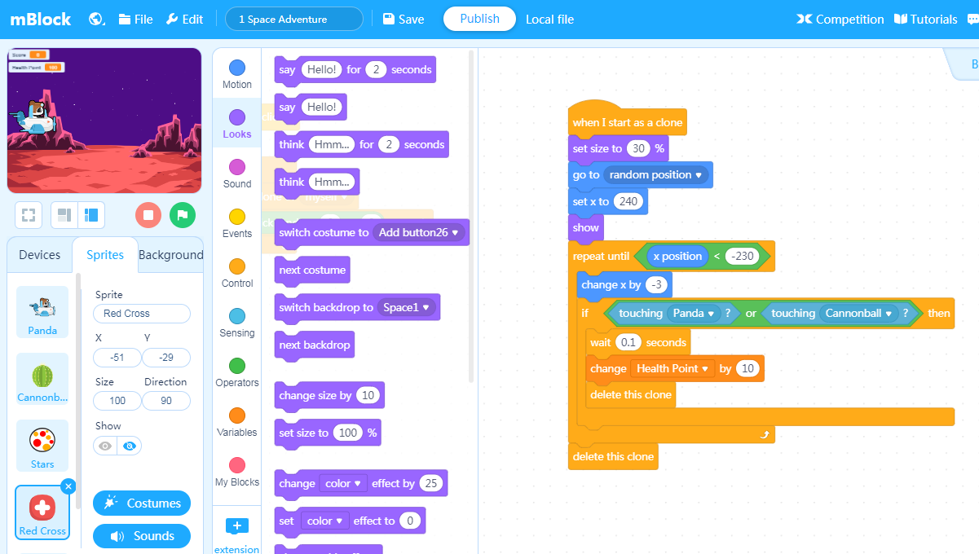

Menu bar
Select language, open new file or save file, find example programs or help documents, etc.
Stage Area
Block Area
Script Area
View project stage, customize sprites and backgrounds, connect Makeblock devices
Library of programming blocks sorted by color-coded categories.
Drag the programming blocks to this area and arrange them to control the performance in the Stage Area.

Slide 4




Icon | Name | Function
Green flag
Start the program
Stop
Stop the program
Full screen demonstration
Start full screen mode
Exit full screen
Exit full screen mode

Slide 5
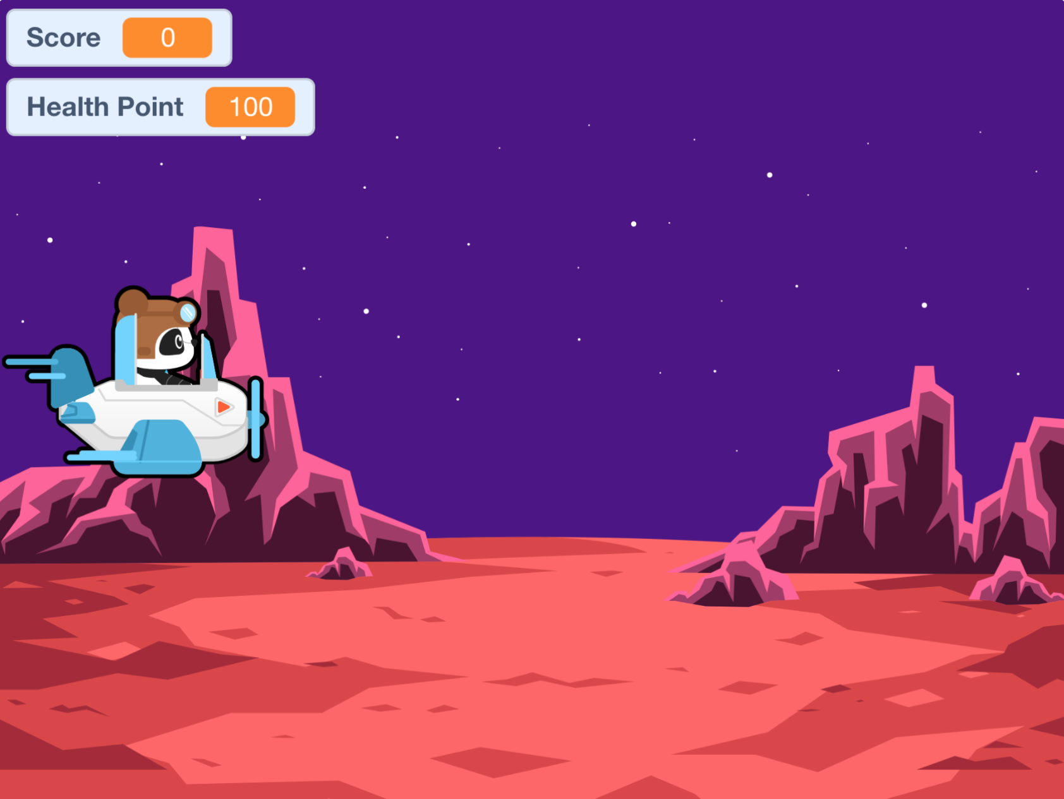

Slide 6
Hands-On

Slide 7
Make a
Sprite Speak

Slide 8
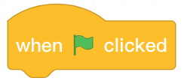


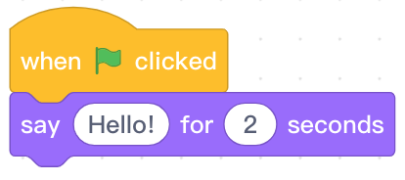



Programming Blocks
Block area | Block | Function | Example
Start event. Execute the subsequent instruction blocks attached to this block after clicking the green flag.
Say “Hello!” for 2 seconds. The phrase and duraction can be changed.
Continuously say “Hello!”. The phrase can be changed.

Slide 9
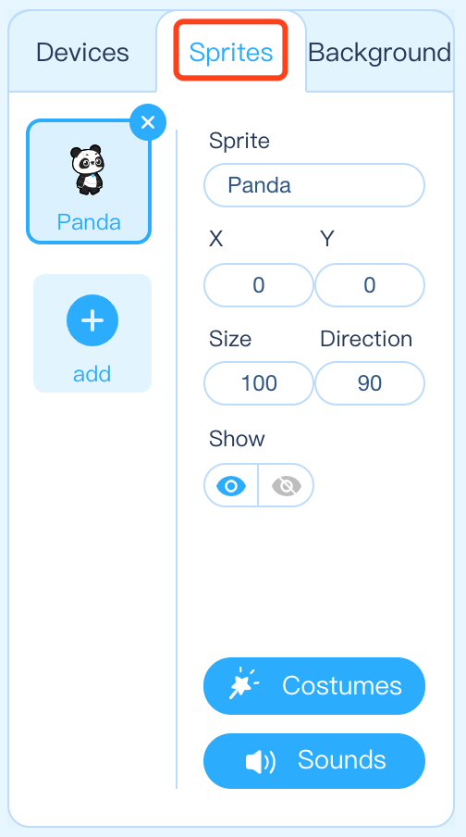
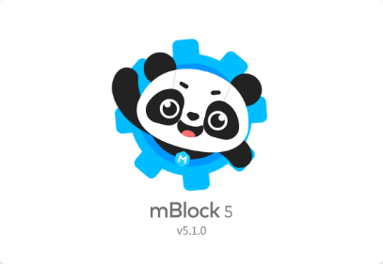
Step 1: Open the mBlock software. Create a new file and click the Sprites tab in the Stage Area to ensure that we are programming the Panda sprite.
Notes:
教师：首先鼠标左键双击打开慧编程软件，打开以后找到“角色”。

Slide 10

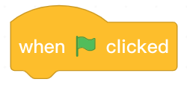
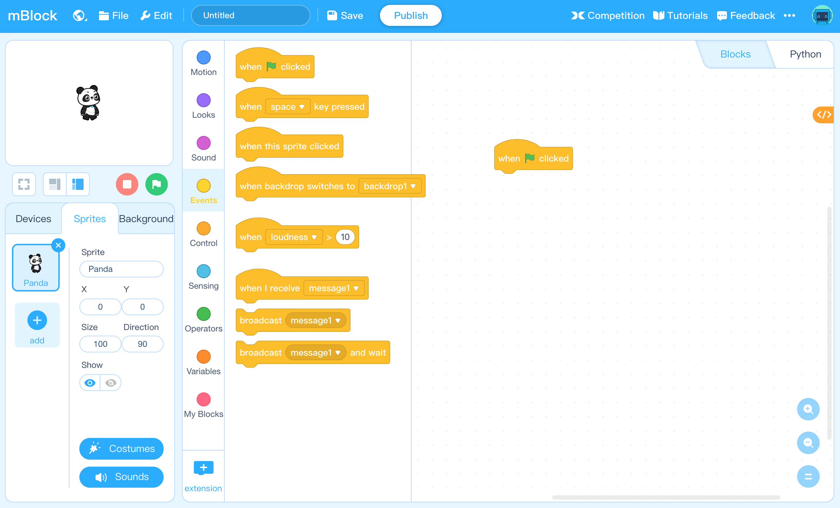
Step 2: Find and select from the block area. Click and drag the block to the Script Area and then release it.

Slide 11


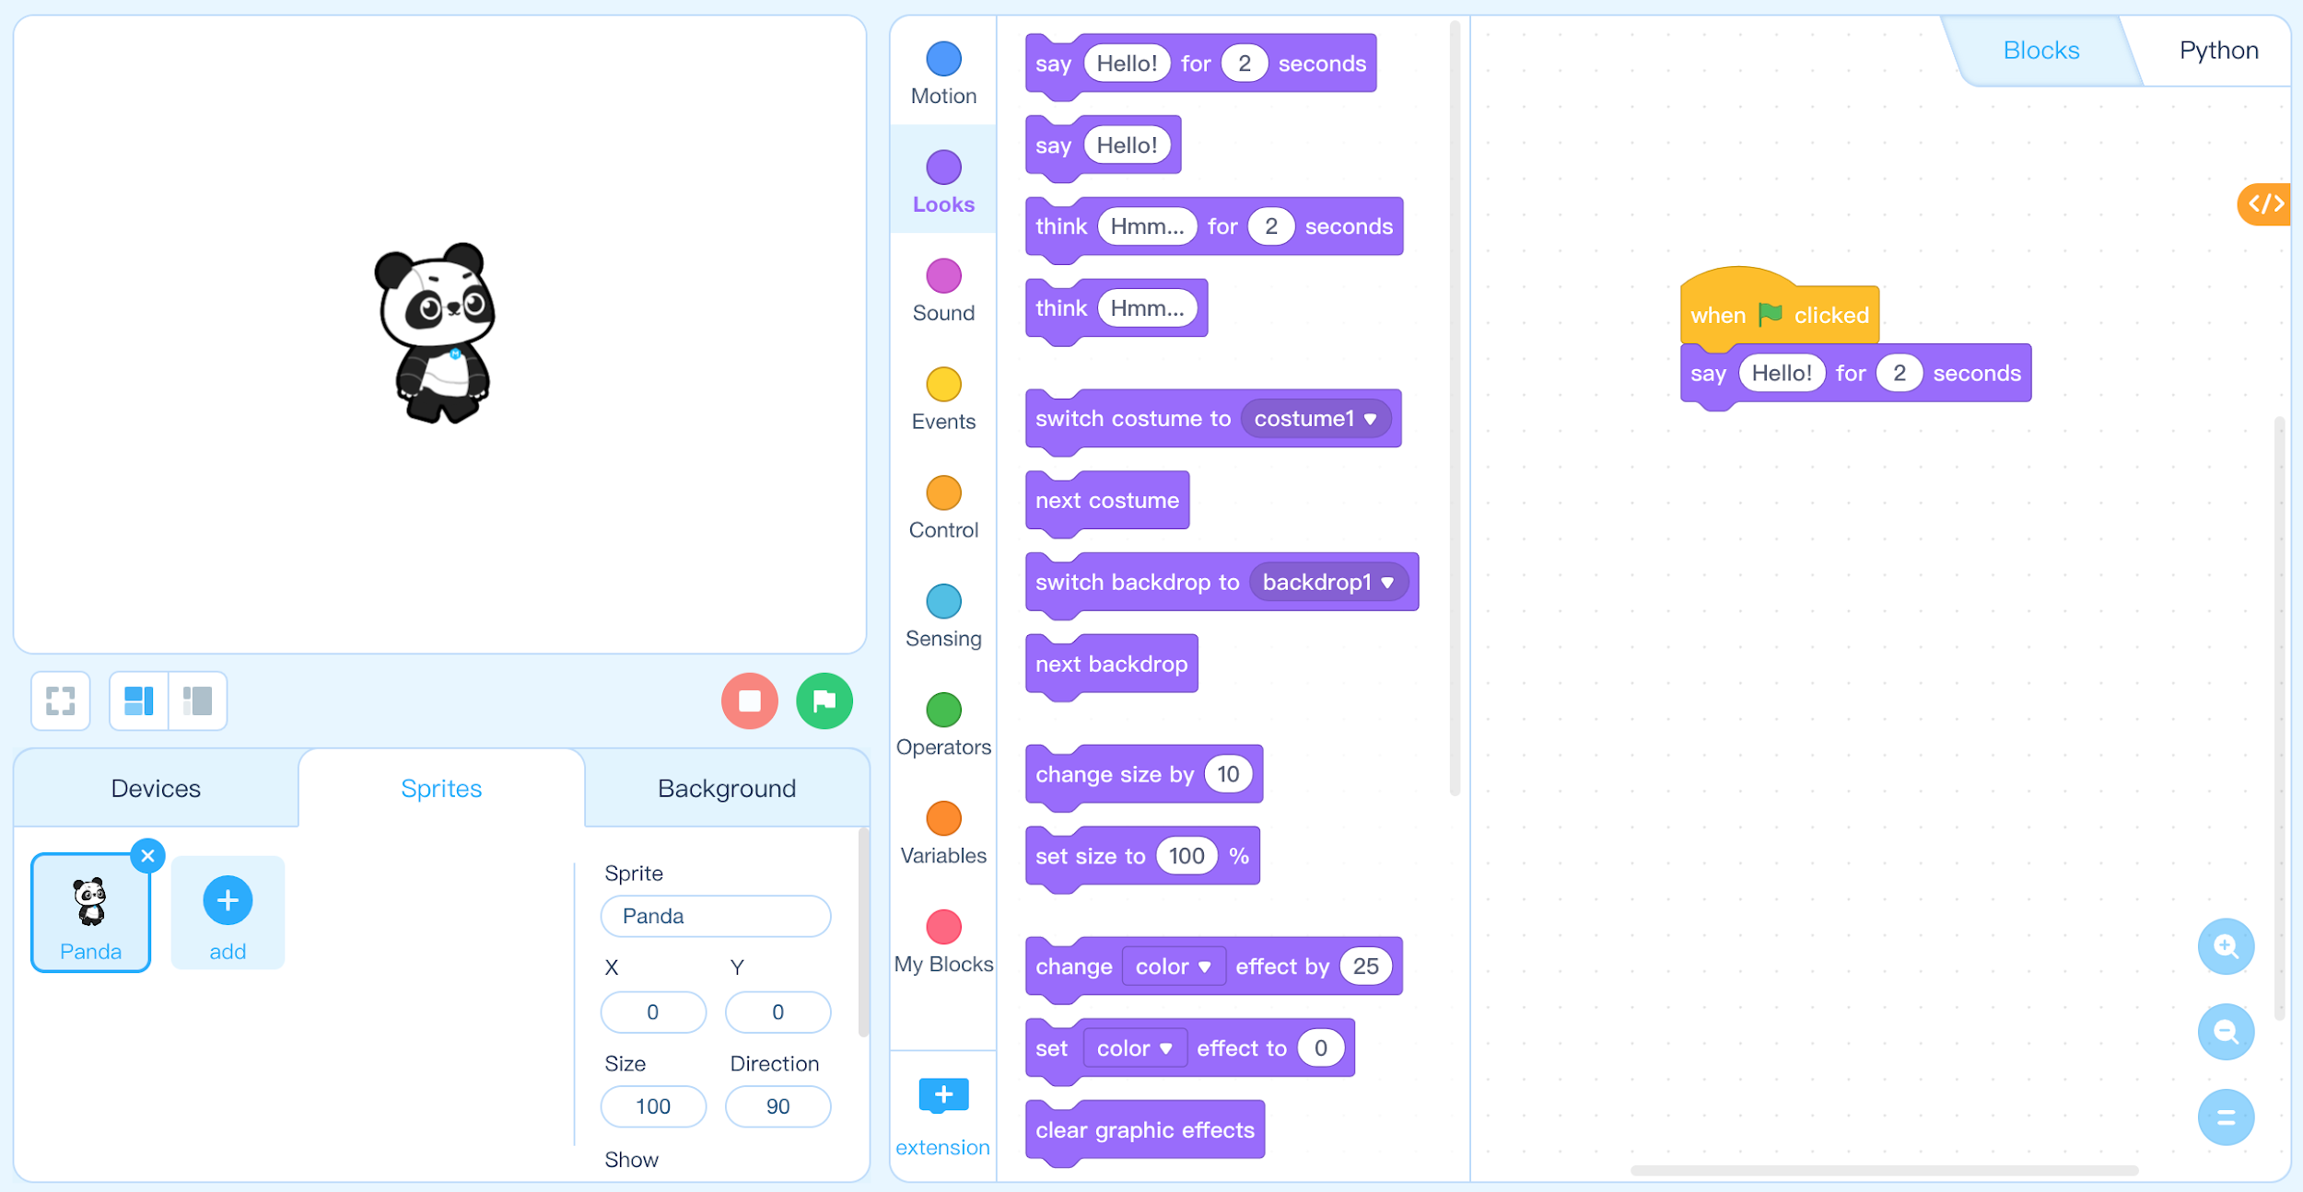
Step 3: Find and select from the Block Area. Click and drag the block to the Script Area and attach it beneath the block.

Slide 12




Step 4: Click the in the Stage Area to run the program and observe Panda speaking.
Step 5: Click and drag the block from the Script Area to the Block Area. The block will be deleted from the Script Area.
Step 6: Find and select from the Block Area. Click and drag the block to the Script Area and attach it beneath the block.
Step 7: Click the in the Stage Area to run the program and observe Panda
speaking.
Step 8: Have students compare and contrast the difference between the
and blocks.

Slide 13
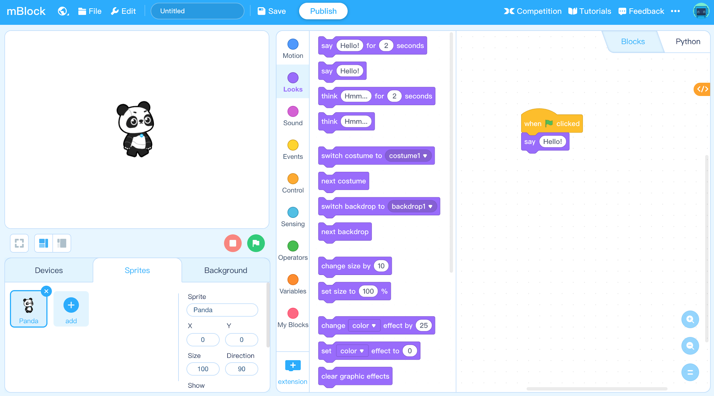

Slide 14
Add a Background

Slide 15


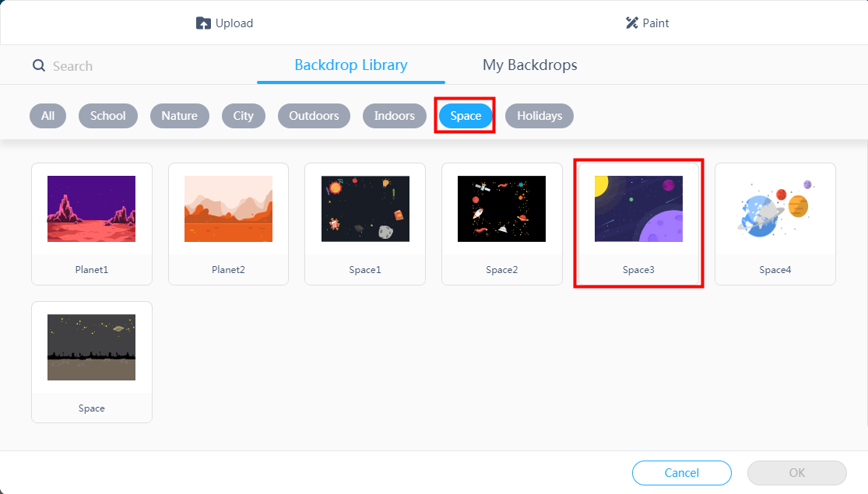
Step 1: Click Background tab in the Stage Area and click .
Step 2: Enter Backdrop Library, click the filter, then select the Space3 backdrop, and then click OK.

Slide 16
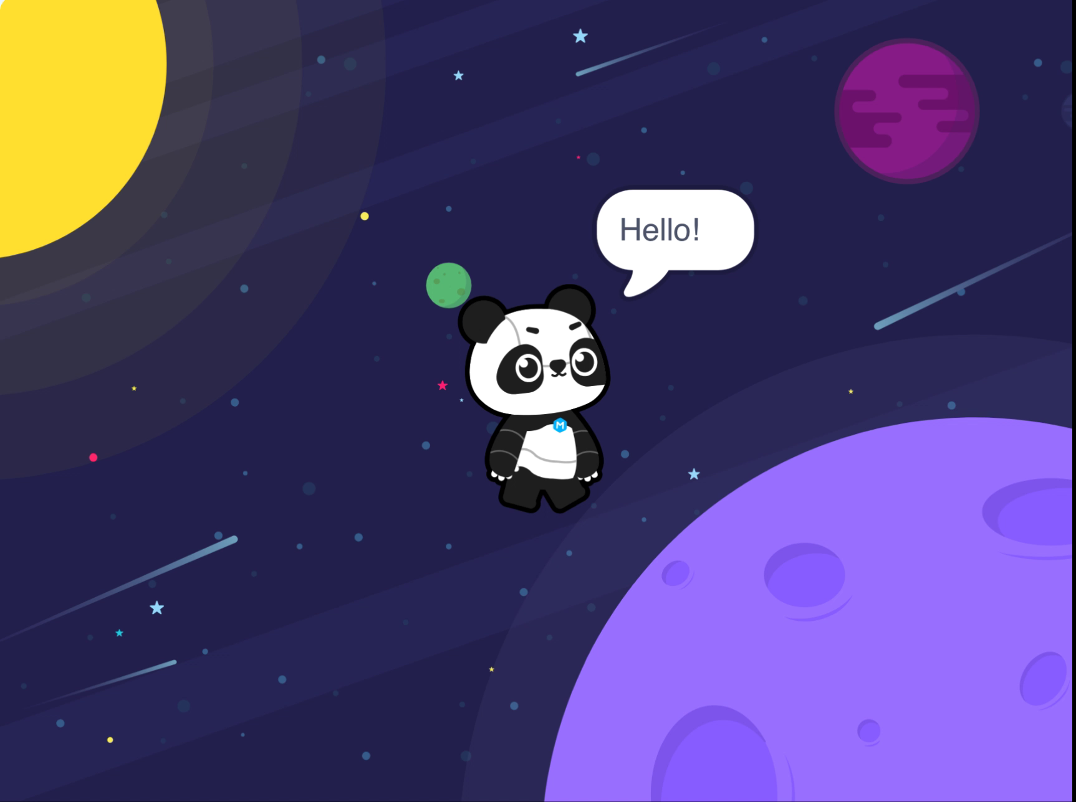

Slide 17
Try It

Slide 18
Programming Practice
Program Panda’s introduction that you wrote in the warm-up.
Extension Challenges:
Add a motion animation to have Panda move across the stage.
Add an additional sprite who also introduces themselves.
Change the event to something besides

Slide 19
Let’s Share!

Slide 20
Share Your Project

Slide 21
Review

Slide 22






1. Which block area does and belong to?
A.
B.
C.
D.
Notes:
Answer: B

Slide 23
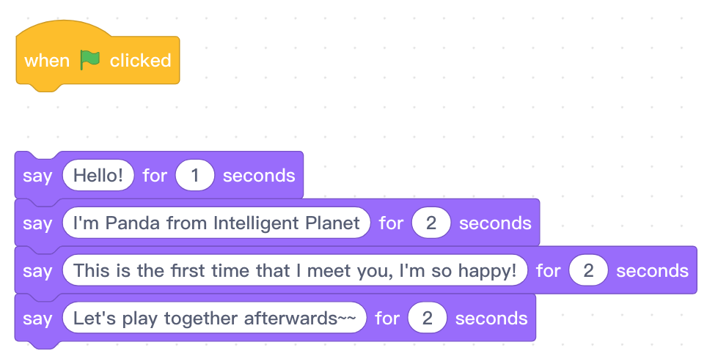
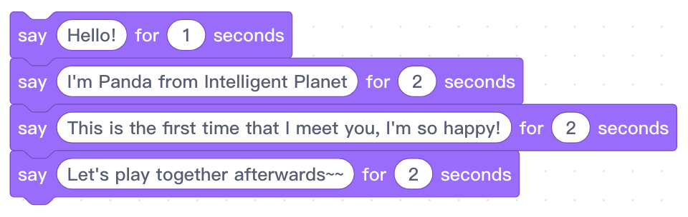
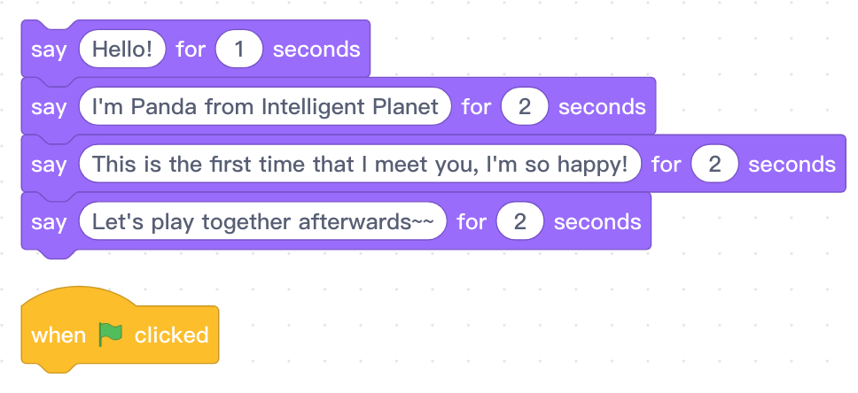
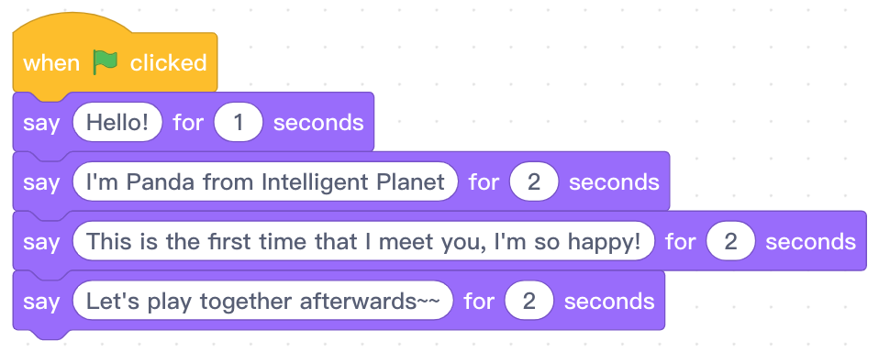
2. Which of the following programs can make Panda successfully
introduce itself?
A.
B.
C.
D.
Notes:
Answer: D

Slide 24

3. If you want to save the file, you will need to find the file button.
Where is this button: ?
A. Block Area
B. Stage Area
C. Script Area
D. Menu Bar
Notes:
教师：文件按钮在菜单栏里。

Slide 25
Thank you!

